Slide 1
Stakeholder engagement
Your logo

Slide 2

Agenda
Borealis overview
Why use Borealis?
Use cases overview
Before we start
Access to Borealis
Key introduction videos
Using Borealis for your day-to-day activities

Slide 3

Before we start…

Slide 4
Do you have access to Borealis ?
Insert here your instance name:
You should be able to log to your instance through this link:
www.xxxxxxx.boreal-is.com
If you experiment issues to log in:
1. Refer to our Helpcenter articles
XXX@XXX.com
3. Contact our helpdesk
helpdesk@boreal-is.com
Access Borealis
2. Contact your superuser

Slide 5
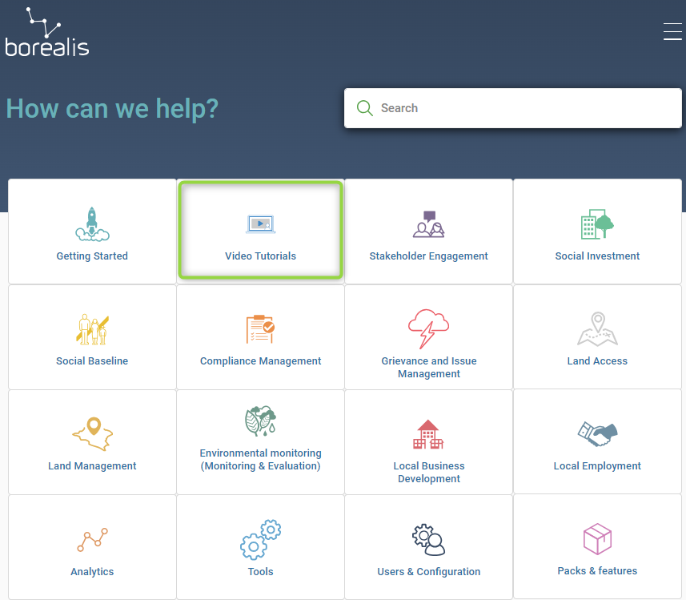
Have you watched the key introduction videos?
To familiarize yourself with the Borealis interface, we highly recommend you to watch the following videos:
Stakeholder Engagement - Introduction Videos
Basic Navigation
Introduction to Individuals
Introduction to Organisations
Introduction to stakeholder positions
Introduction to Communications
Introduction to the Outlook add-In

Slide 6
Borealis overview

Slide 7
Why use Borealis ?
A new tool. What for?
What’s in it for our team ?
What’s in it for me ?

Slide 8
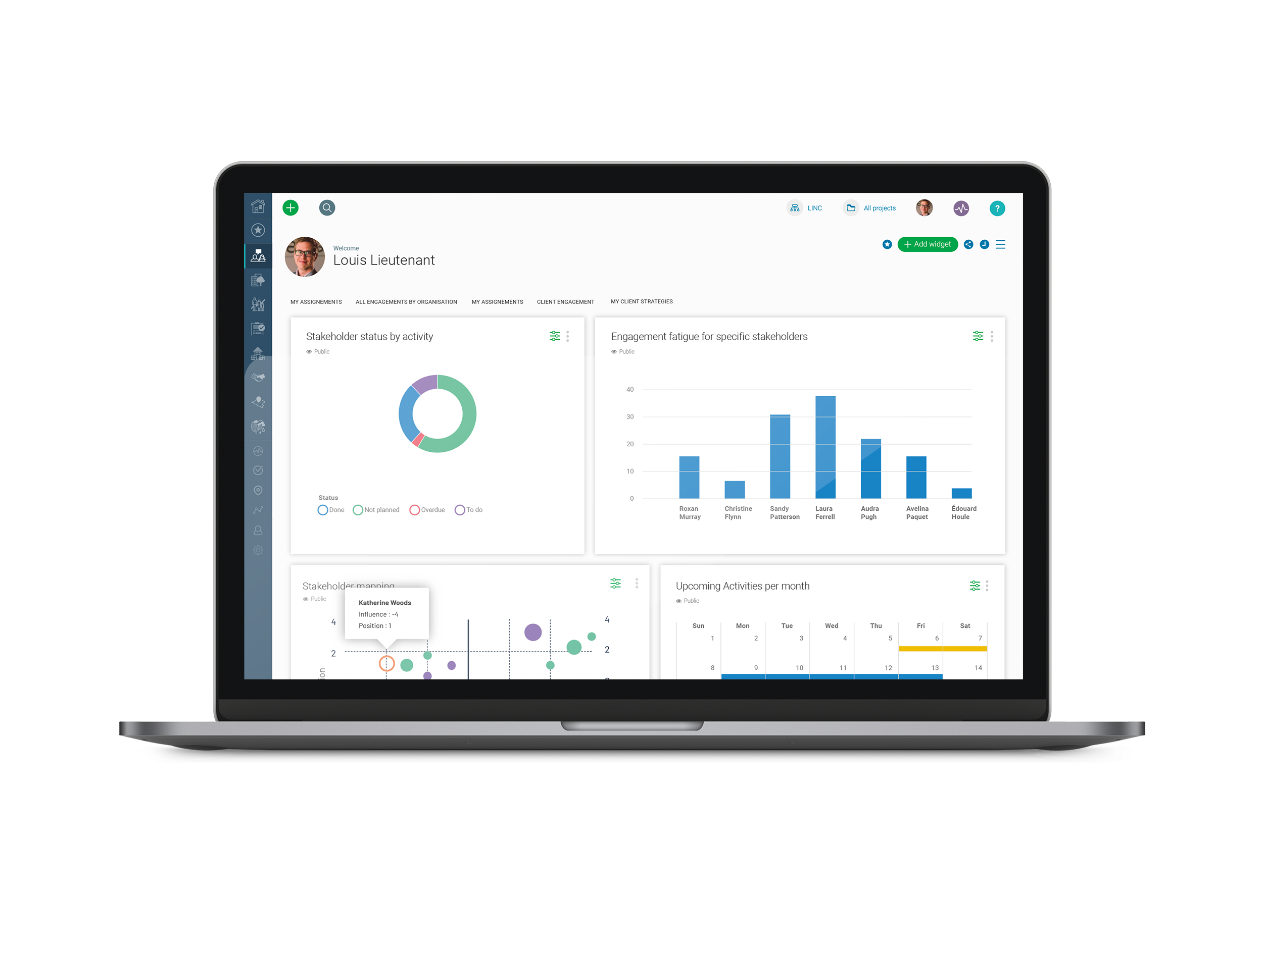
What is Borealis?
A cloud-based stakeholder engagement software for storing, sharing, and reporting on stakeholder data and related engagement activities
Complies with the highest industry standards for enterprise security to ensure the confidentiality, integrity, and availability of your information.
It is customizable to meet organization’s objectives based on industry best practices.

Slide 9
Processes that will be managed in Borealis
Insert here your list of use cases: Use cases correspond to the processes you aim to implement in Borealis. For example:
Track interactions with your stakeholders
Organize stakeholders to define an engagement strategy
…
…
…

Slide 10

Track interactions with your stakeholders

Slide 11
Use case overview
Break silos, by centralizing information into a single system
Give visibility on all communications around a given stakeholder or on a given topic
Track any communication your team may receive: E-mails, phone calls, SMS, letters…
Track any communication your team may initiate: E-mails, phone calls, SMS, letters…
Track any meeting your team may attend: online call, conference, face-to-face
Outlook add-in is installed
This Use case should be considered as an example. Customize each text to your process.

Slide 12
Mapping and components
Customize each text to your process.
“Matching naming conventions’ consist in mapping your vocabulary with the registers or fields available in Borealis
Key components used
Outlook / G-mail add-in
Individuals
Communications
Key information tracked
Type of communication
Sentiment
Matching naming conventions
Individuals
Communications
People
E-mails
Linked through a position
Formal meetings
Events
Organizations
In-person meetings
Companies
NGO
Government agencies…
Phone calls

Slide 13
Associated process
Customize each text to your process.
Create and assign a task
Receive e-mails in Mailbox
Use add-in or e-mail alias to send to Borealis
Yes
Is a follow-up required?
Consult report
No
Send e-mail from Mailbox
Use add-in or e-mail alias to share with Borealis

Slide 14

Use case XXX

Slide 15
Use case overview
Purpose
Main activities

Slide 16
Mapping and components
Key components used
Matching naming conventions

Slide 17
Associated process

Slide 18
Discussion
Questions?

