Slide 1
Borealis: Stakeholder Management Tool
1) Review and adjust all content in yellow.
2) Then, remove.
Use your branded organizational template and images to customize further.
Organizational introduction

Slide 2
Agenda
Add, edit or remove agenda items as desired
Borealis in a nutshell
Organizational goal
Organizational Benefits
What’s in it for you?
Next steps

Slide 3
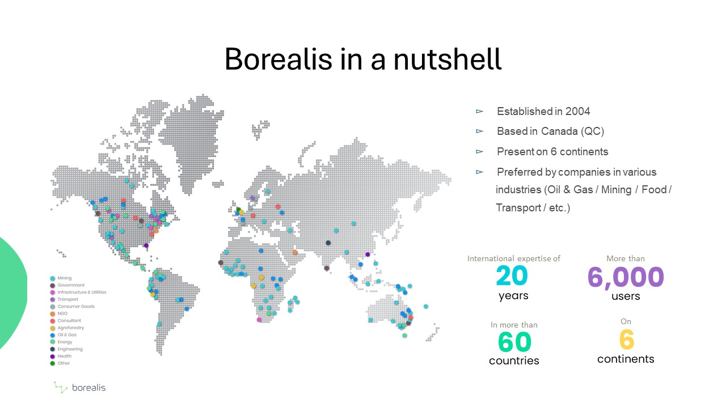

Slide 4
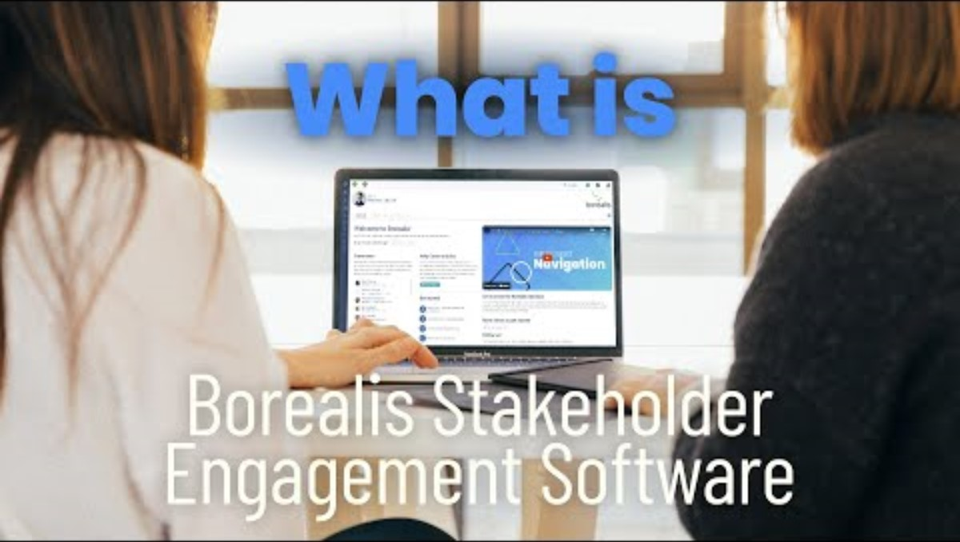
What is Borealis?
Borealis is a customizable, web-based, stakeholder relationship management software application.
It is a database where you store information about your stakeholders - individuals and organizations - and your interactions with them.

Slide 5














Core module: Stakeholder Engagement
Identify your stakeholders
Record your interactions
Organize your work
Generate your reports
Emails
Distribution lists
Tasks
Activites
Organisations
Individuals
Widget 1
Widget 2
Position
Meetings
125
Calls
Widget 3
Widget 4
Related rganisations
Individuals
Events
Engagement plans

Slide 6
Organizational goal(s)
What does your organization hope to achieve by implementing Borealis?
This slide is pre-populated with some of the reasons why clients choose Borealis.
Add, edit or remove as relevant.
Centralize all stakeholder-related information
Improve internal transparency around engagement activities
Build institutional memory
Improve reporting on engagement and corporate social responsibility/Meet compliance requirements
Enhance targeted engagement efforts based on evaluation and analysis of past engagements

Slide 7
Organizational benefits
How will things be better by implementing Borealis?
Refer to the worksheet Identifying the case for change and change vision.
This slide is pre-populated with some of the benefits of using Borealis. Add, edit or remove as relevant based on the modules and add-ons you have purchased.
Organize stakeholders based on their interest and alignment with your work.
Tracking multiple points of contact between your staff and staff at various stakeholder organizations.​
Helping understand stakeholder concerns and past interactions before reaching out.​
Streamlining and simplifying reporting on engagements.
Identifying gaps in programming/outreach.
Supporting more targeted engagement planning by segmenting stakeholders by interest/geography/sector/etc.​
Generating and storing distribution lists for communication with groups, such as community reference groups, landowners, committee members, etc.
(Grievance module) Manage complaints from start to finish, tracking time to close and outcomes
(Smart comms) Managing subscription lists, generating mailouts and tracking engagement like open rate, most read, replies, etc.

Slide 8
What’s in it for you?
Tailor your key messages for your audience.
Refer to the worksheet Identifying the case for change and change vision.
This slide is pre-populated with some ways that clients have highlighted individual benefits to their staff. Add, edit or remove as relevant based on the modules and add-ons you have purchased.
Tools to make it quick and easy to record engagements (Outlook add-in/mobile app), even while away from your desk
Searchable, filterable database of stakeholder information
Easy to read and visually attractive reports that can be exported and shared
Traceable record of interactions with challenging stakeholders
(Land Management) Easily identifying landowners and tenants impacted by company assets

Slide 9
Next steps
This is a general timeline of the onboarding process, if you follow a Waterfall methodology.
(for an Agile approach, see next slide).
If you choose to include it, consider adding dates, including the names of the project team and/or superusers.
Project team:
Superusers:
Kickoff date:
Requirements gathering
System configuration
Import existing data
Validation and user testing
Training
Go-Live!

Slide 10
Next steps
This is a general timeline of the onboarding process, if your follow a Agile approach.
If you choose to include it, consider adding dates, including the names of the project team and/or superusers.
Project team:
Superusers:
Kickoff date:
Requirements gathering
Out-of-the-box instance in online
Instance configured, ready for use
Sprint 1 completion
Sprint 2 completion
Project closure

